Slide 1

Where Partner Brands Live.
A map of where a business and a user sees brand presence.
May 2026 · Product & Design​

Slide 2
Contents.
Context
Example prototype
Surface Architecture

Slide 3
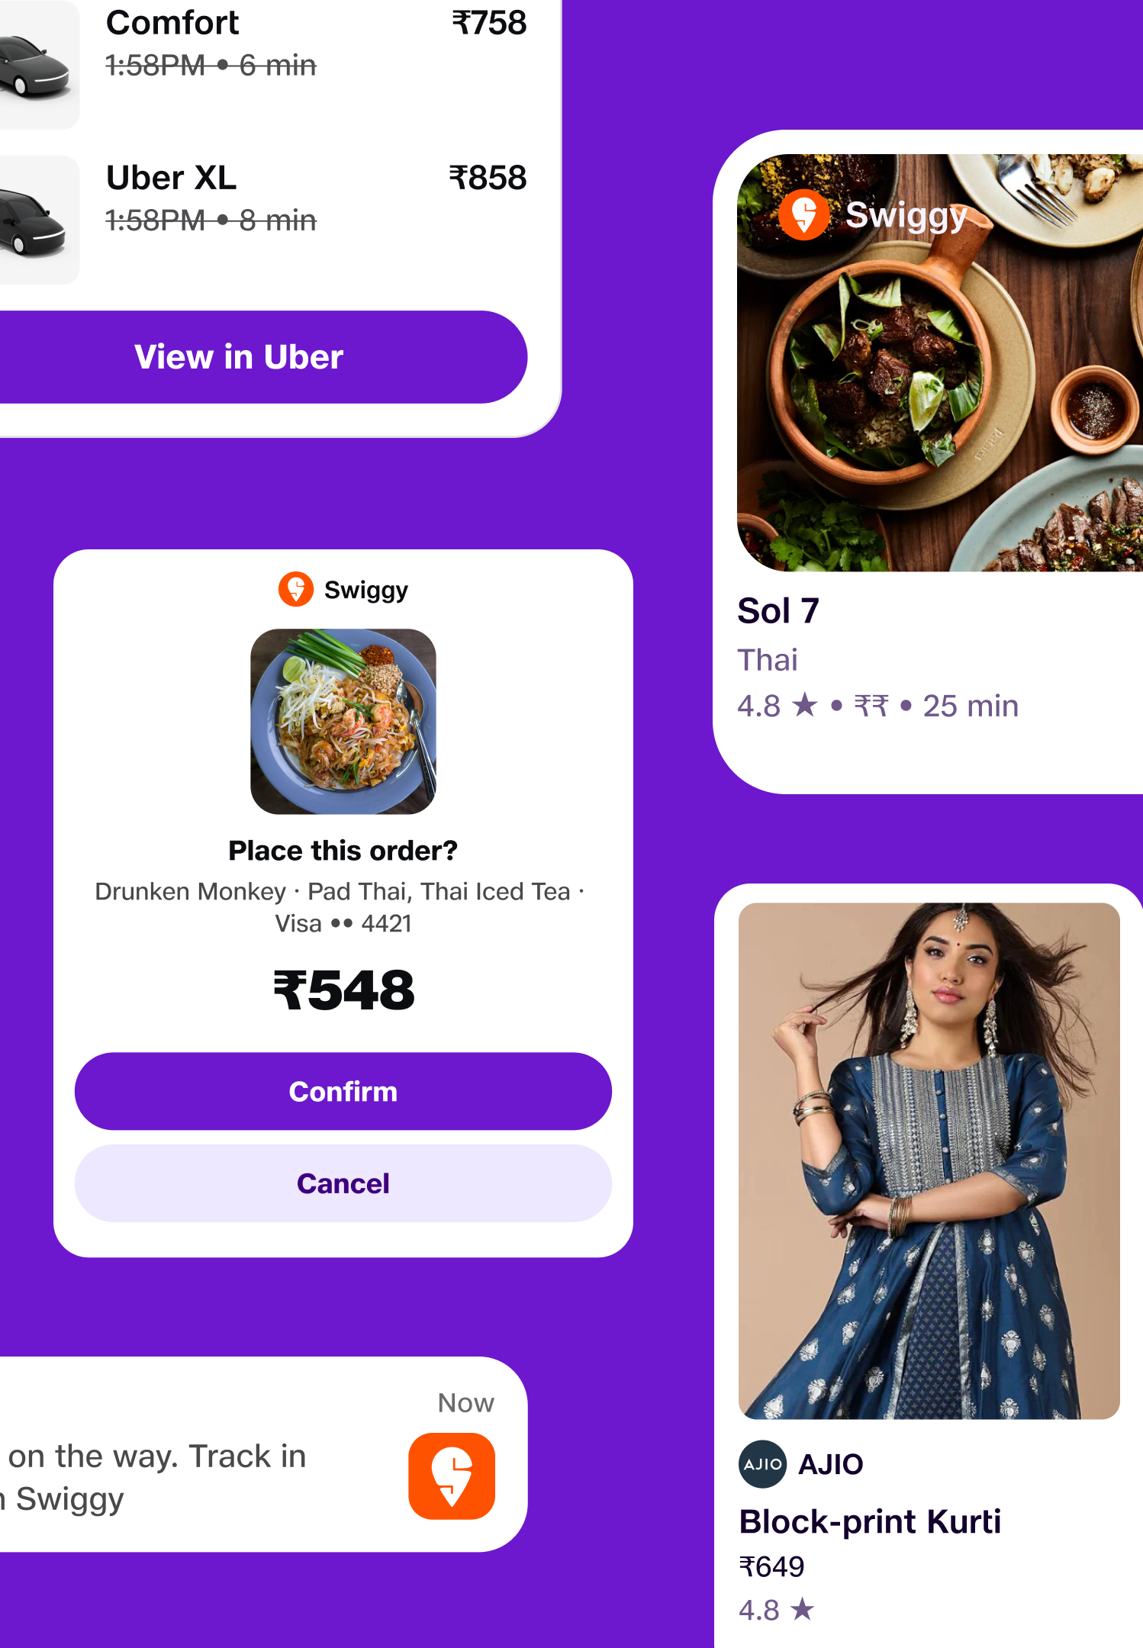
When a partner connects to JBIQ, where does their brand show up?
The user needs trust signals. The business needs attribution.
The system needs cohesion. Three things to balance, eight surfaces to balance them across.

Slide 4
The experinace partnership
Two forces, one surface.
JBIQ cohesion
Partner attribution
Every experience feels like one product. Predictable rhythm. Consistent voice. One safety layer.
Their brand seen. Their relationship preserved.
Their data, their trust, their continued mindshare.

Slide 5
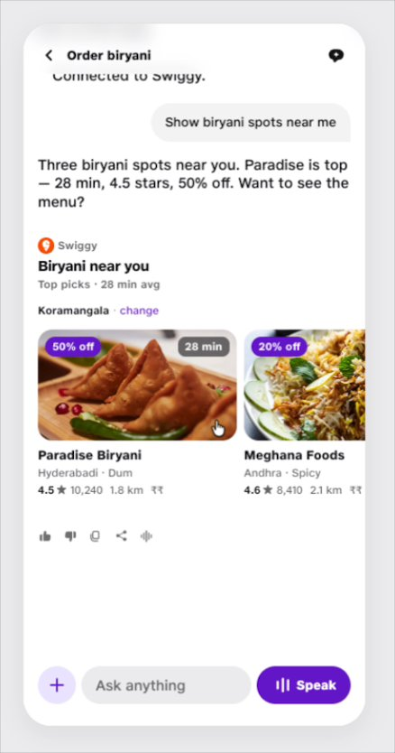
Prototype video walkthrough
Discovery, Order
& Purchase.
JBIQ Conversation Playground Link

Slide 6
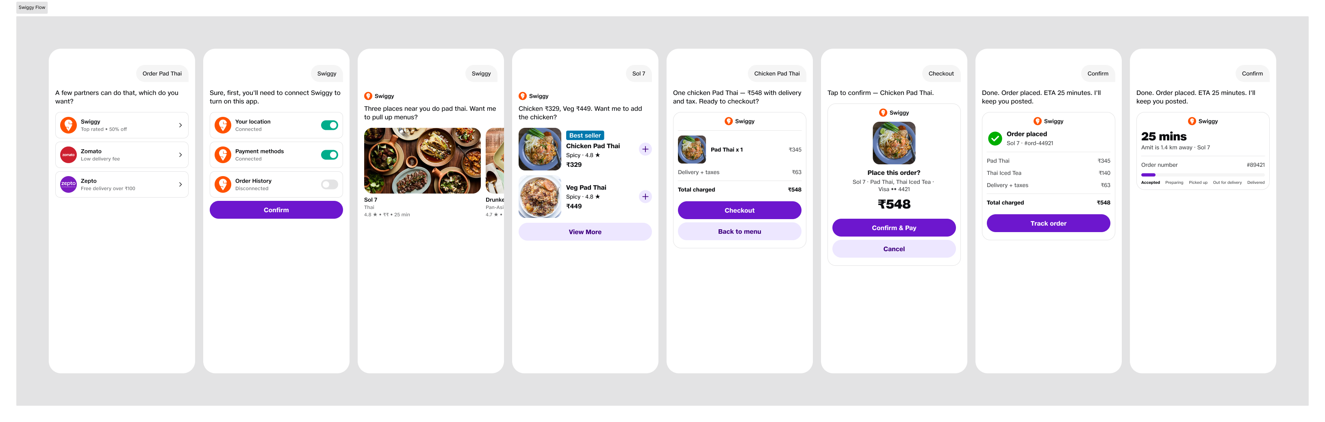
Prototype Flow

Slide 7
Eight surfaces
Where brand shows up.
1.Pre-conversation
2.Session chrome
3.Content
4.Voice attribution
5.Transactional moments
6.History & Re-engagement
7.Trust & compliance
8.Cross-partner views

Slide 8
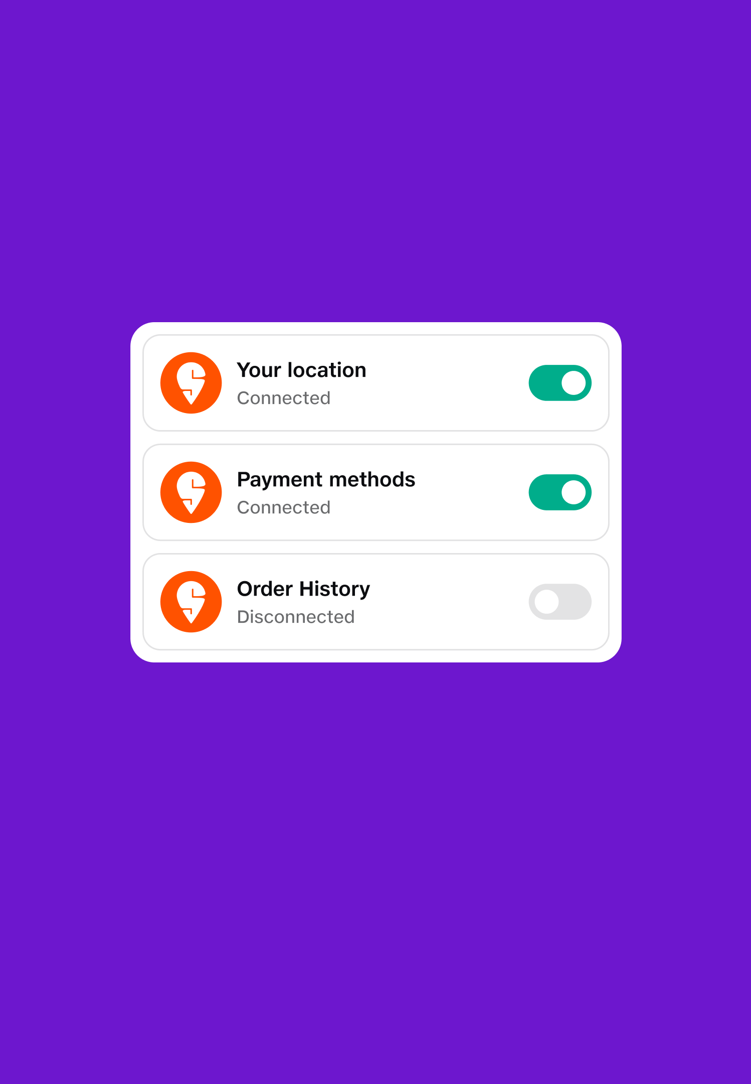
01 Pre-conversation
Where users decide which partners they trust.
The very first impression a partner makes before any tool has fired or any data has been touched.
Partner picker / capability registry "Swiggy, Zomato, or Eatsure for food?"
First-use consent screen partner logo, data scope, allowed actions
Settings → Connected partners the user's mental model of what's plugged in
"Discover partners" surface app-store-like, high real estate
​
User: Trust signals up front.
​Partner: First-impression placement.

Slide 9
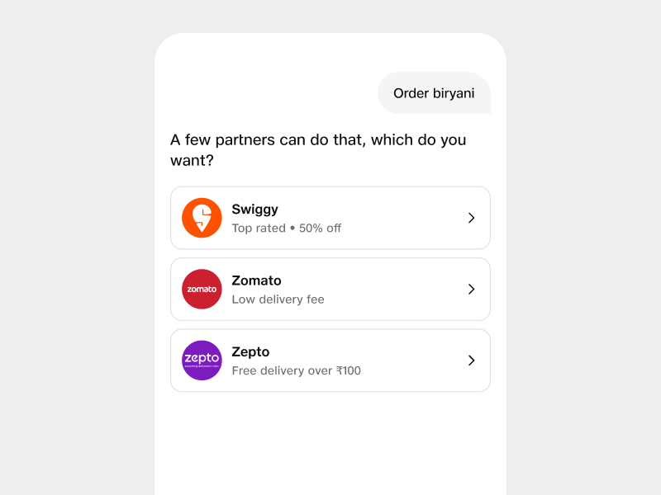
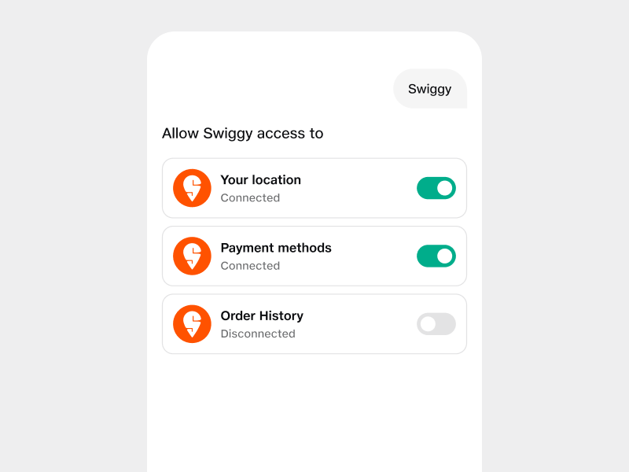
Partner picker
First-use consent
Choose who handles the request
What the partner can see and do
JBIQ surfaces the partners that can fulfil the user's intent. Each option carries its mark and a one-line credential.
Partner logo paired with each data scope the user is granting. Granular, explicit, revocable.

Slide 10
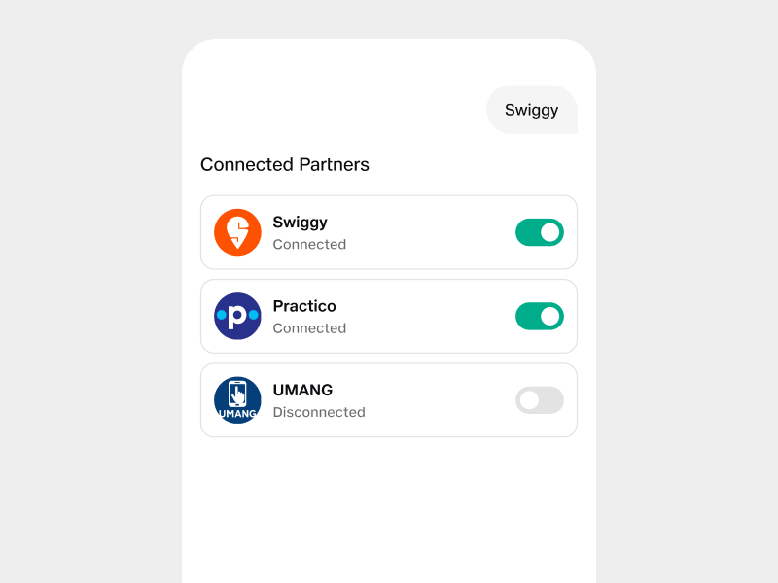
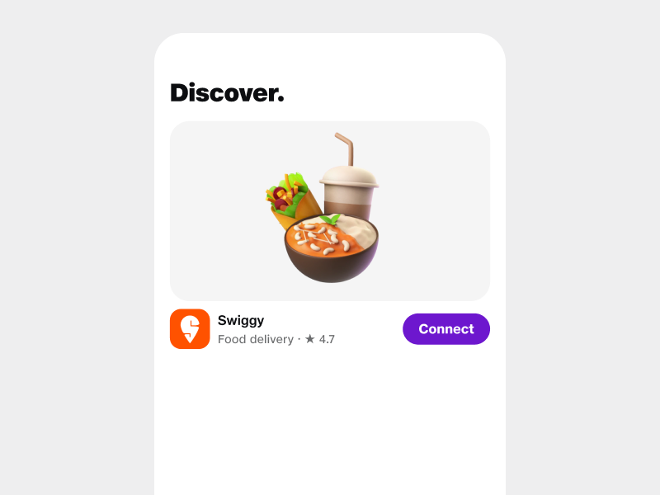
Settings · Connected partners
Discover partners
The user's mental model of their stack
App-store-like featured surface
A single screen showing everyone plugged in. Source of truth for "who has access" and the disconnect button.
Where new partners get their first impression. High real estate, brand-led; users opt in to plug them into the rest of the system.

Slide 11
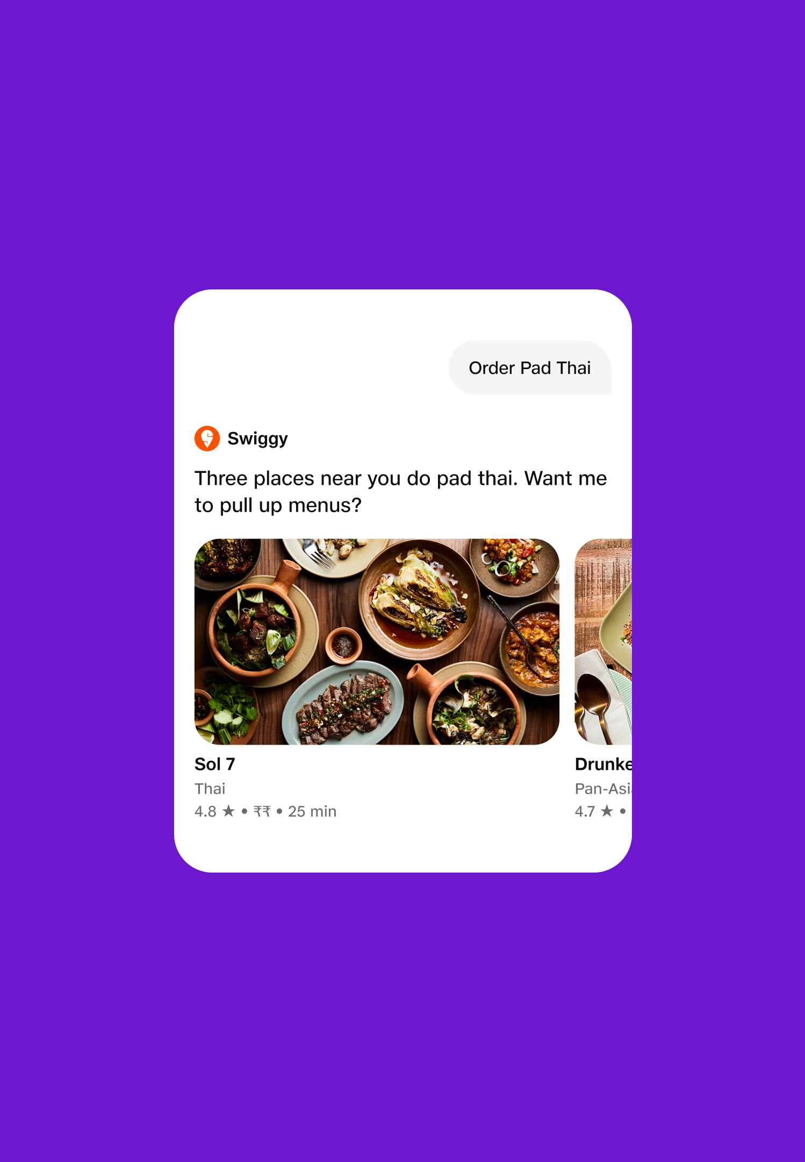
02 Session Chrome
The active partner stays visible without crowding the content.
When a flow is in progress, the user should always know who's behind the answer but it can't compete with the content itself.
Active partner pill at the top of the conversation
Sidebar partner indicator when a flow is in progress
Browser tab / app header reflecting the current partner
Voice intro when a partner takes over "Swiggy here three places near you do pad thai."
​
User: Stays oriented on who's responsible.
​Partner: Framing presence

Slide 12
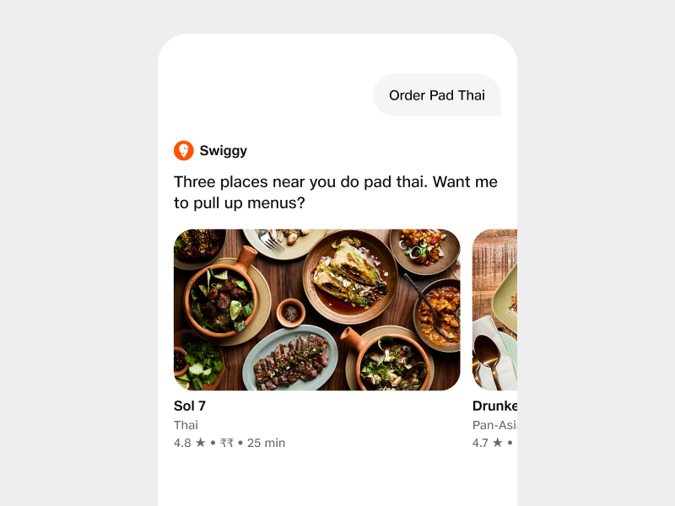
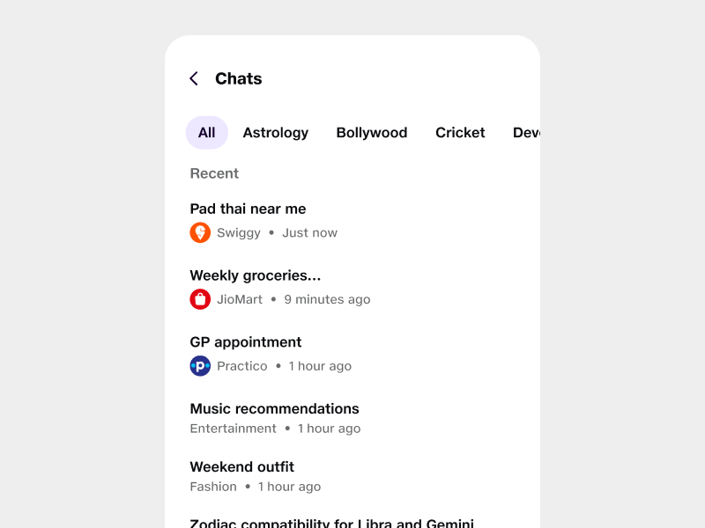
Active partner pill
Sidebar indicator
In-flow partner pill
Sidebar session marker
Sits in the conversation header throughout the flow. Quietly persistent so the user always knows who's behind the answer.
In multi-flow apps, the active partner is marked next to its session entry so users can switch contexts without losing track.

Slide 13
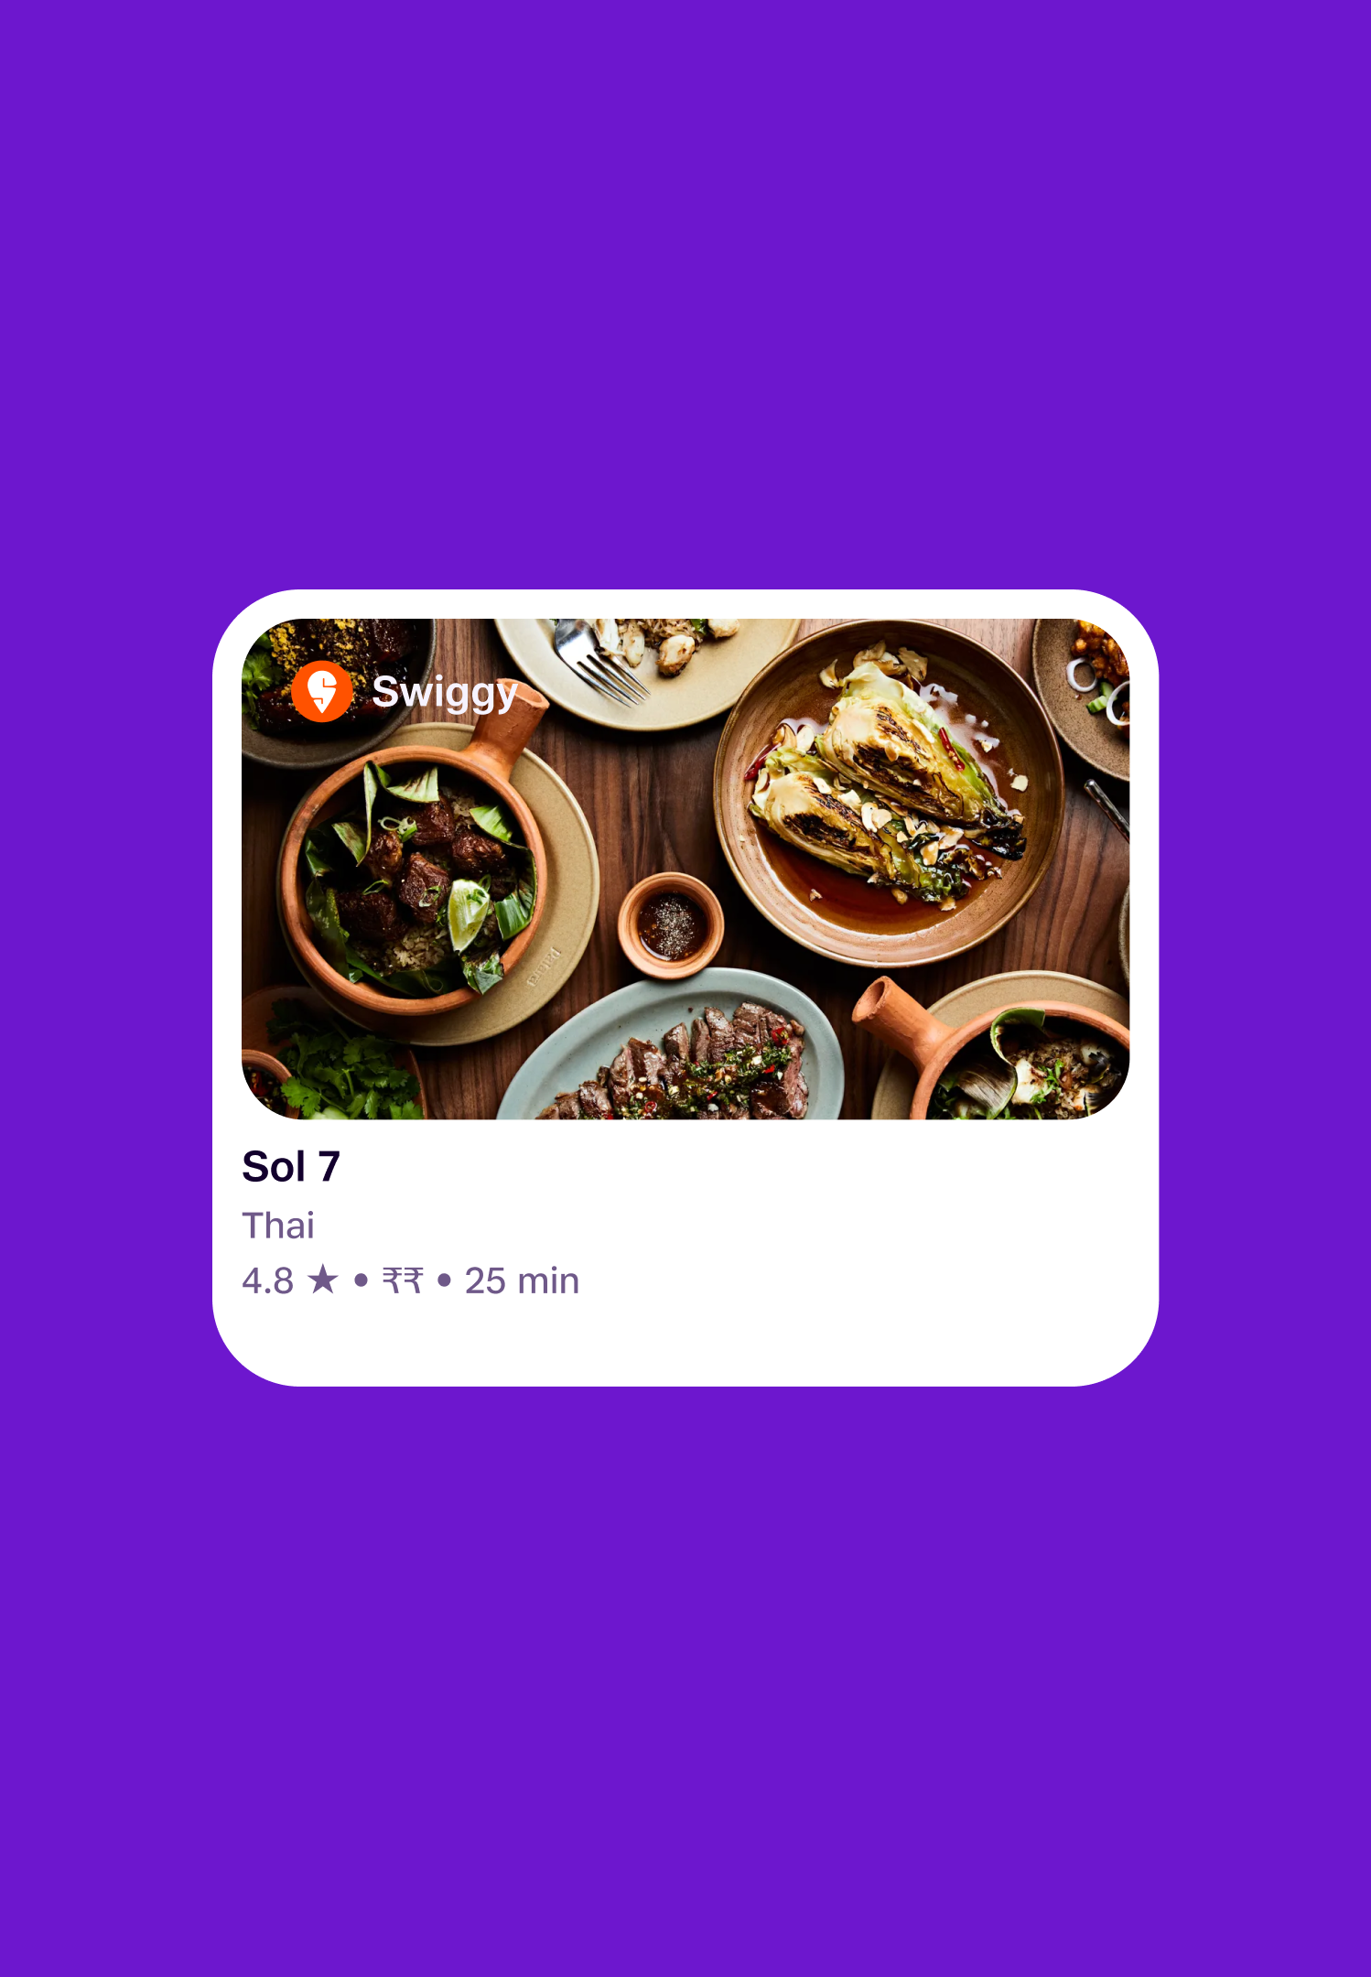
03 Inside content
The highest-stakes surface partners compete here for visibility.
Cards, lists, and trackers are where the user is actively looking. Every placement here trades off against the next.
Card hero / media partner watermark, logo strip, themed colour wash
Card title row small partner mark next to the entity title
Section headers "From Times of India" above a news block
Card footer "via Swiggy" source line
Verification badges system-issued tick, not partner-claimed
​
User: Sees who's source-of-truth for each data point.
​Partner: Prime real estate where eyes actually land.

Slide 14
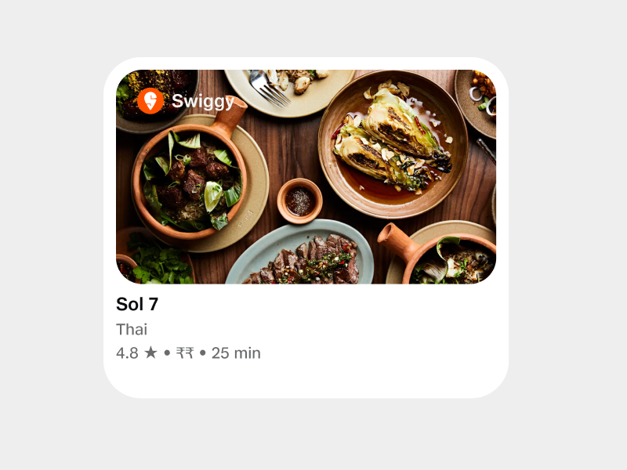
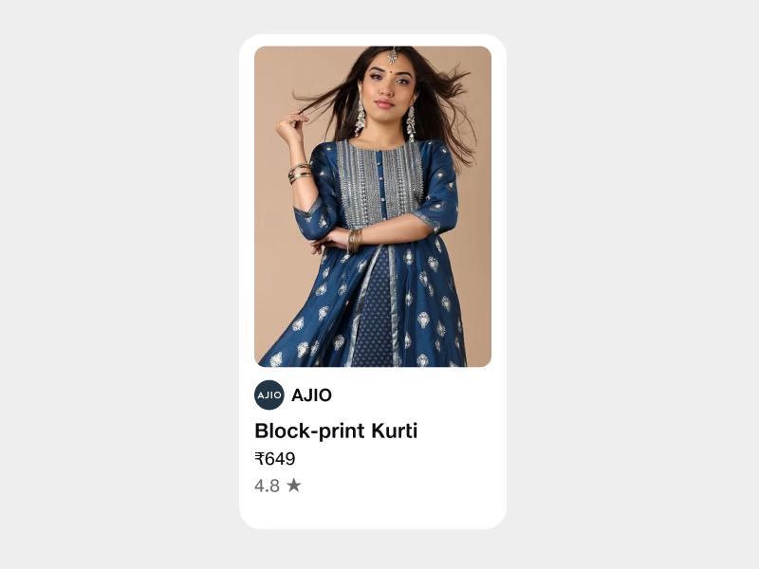
Hero watermark
Title-row mark
Logo strip in the media area
Small logo next to the entity name
Most assertive treatment. Partner's mark spans the top edge of the card's hero. Best when partner brand recognition is doing the heavy lifting.
Quiet but always there. The partner's identity sits inline with the title, so it travels with the entity into search, history, and recommendations.

Slide 15
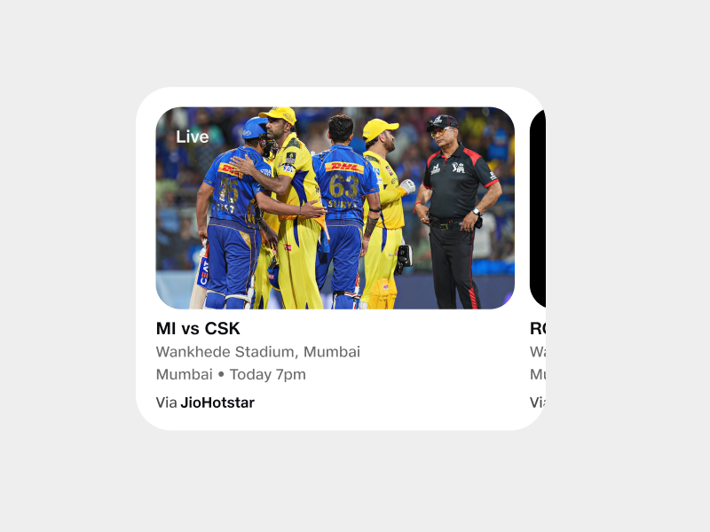
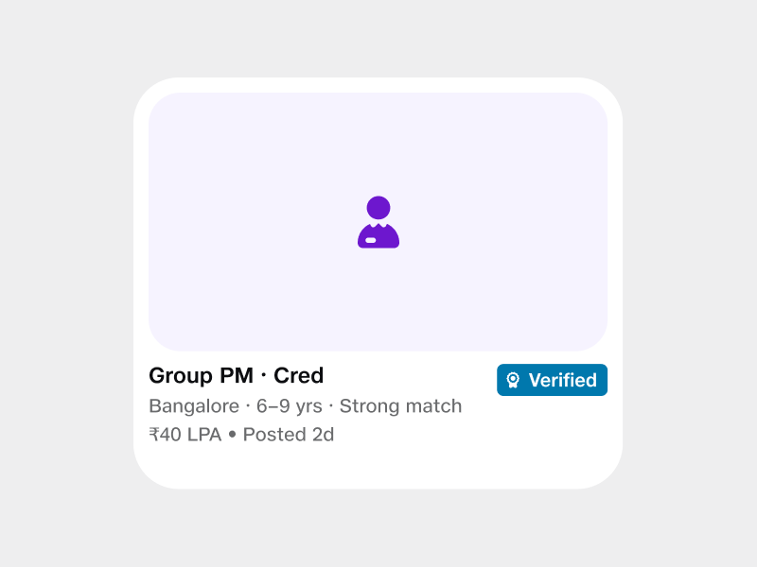
Footer source line
Verification badge
"via Partner" attribution line
System-issued tick
The default-on treatment. Plain text below the card. Reads naturally, never overpowers the data, satisfies attribution without competing for attention.
A trust signal, not a brand placement. Issued by JBIQ after partner verification never claimed or styled by the partner themselves.

Slide 16
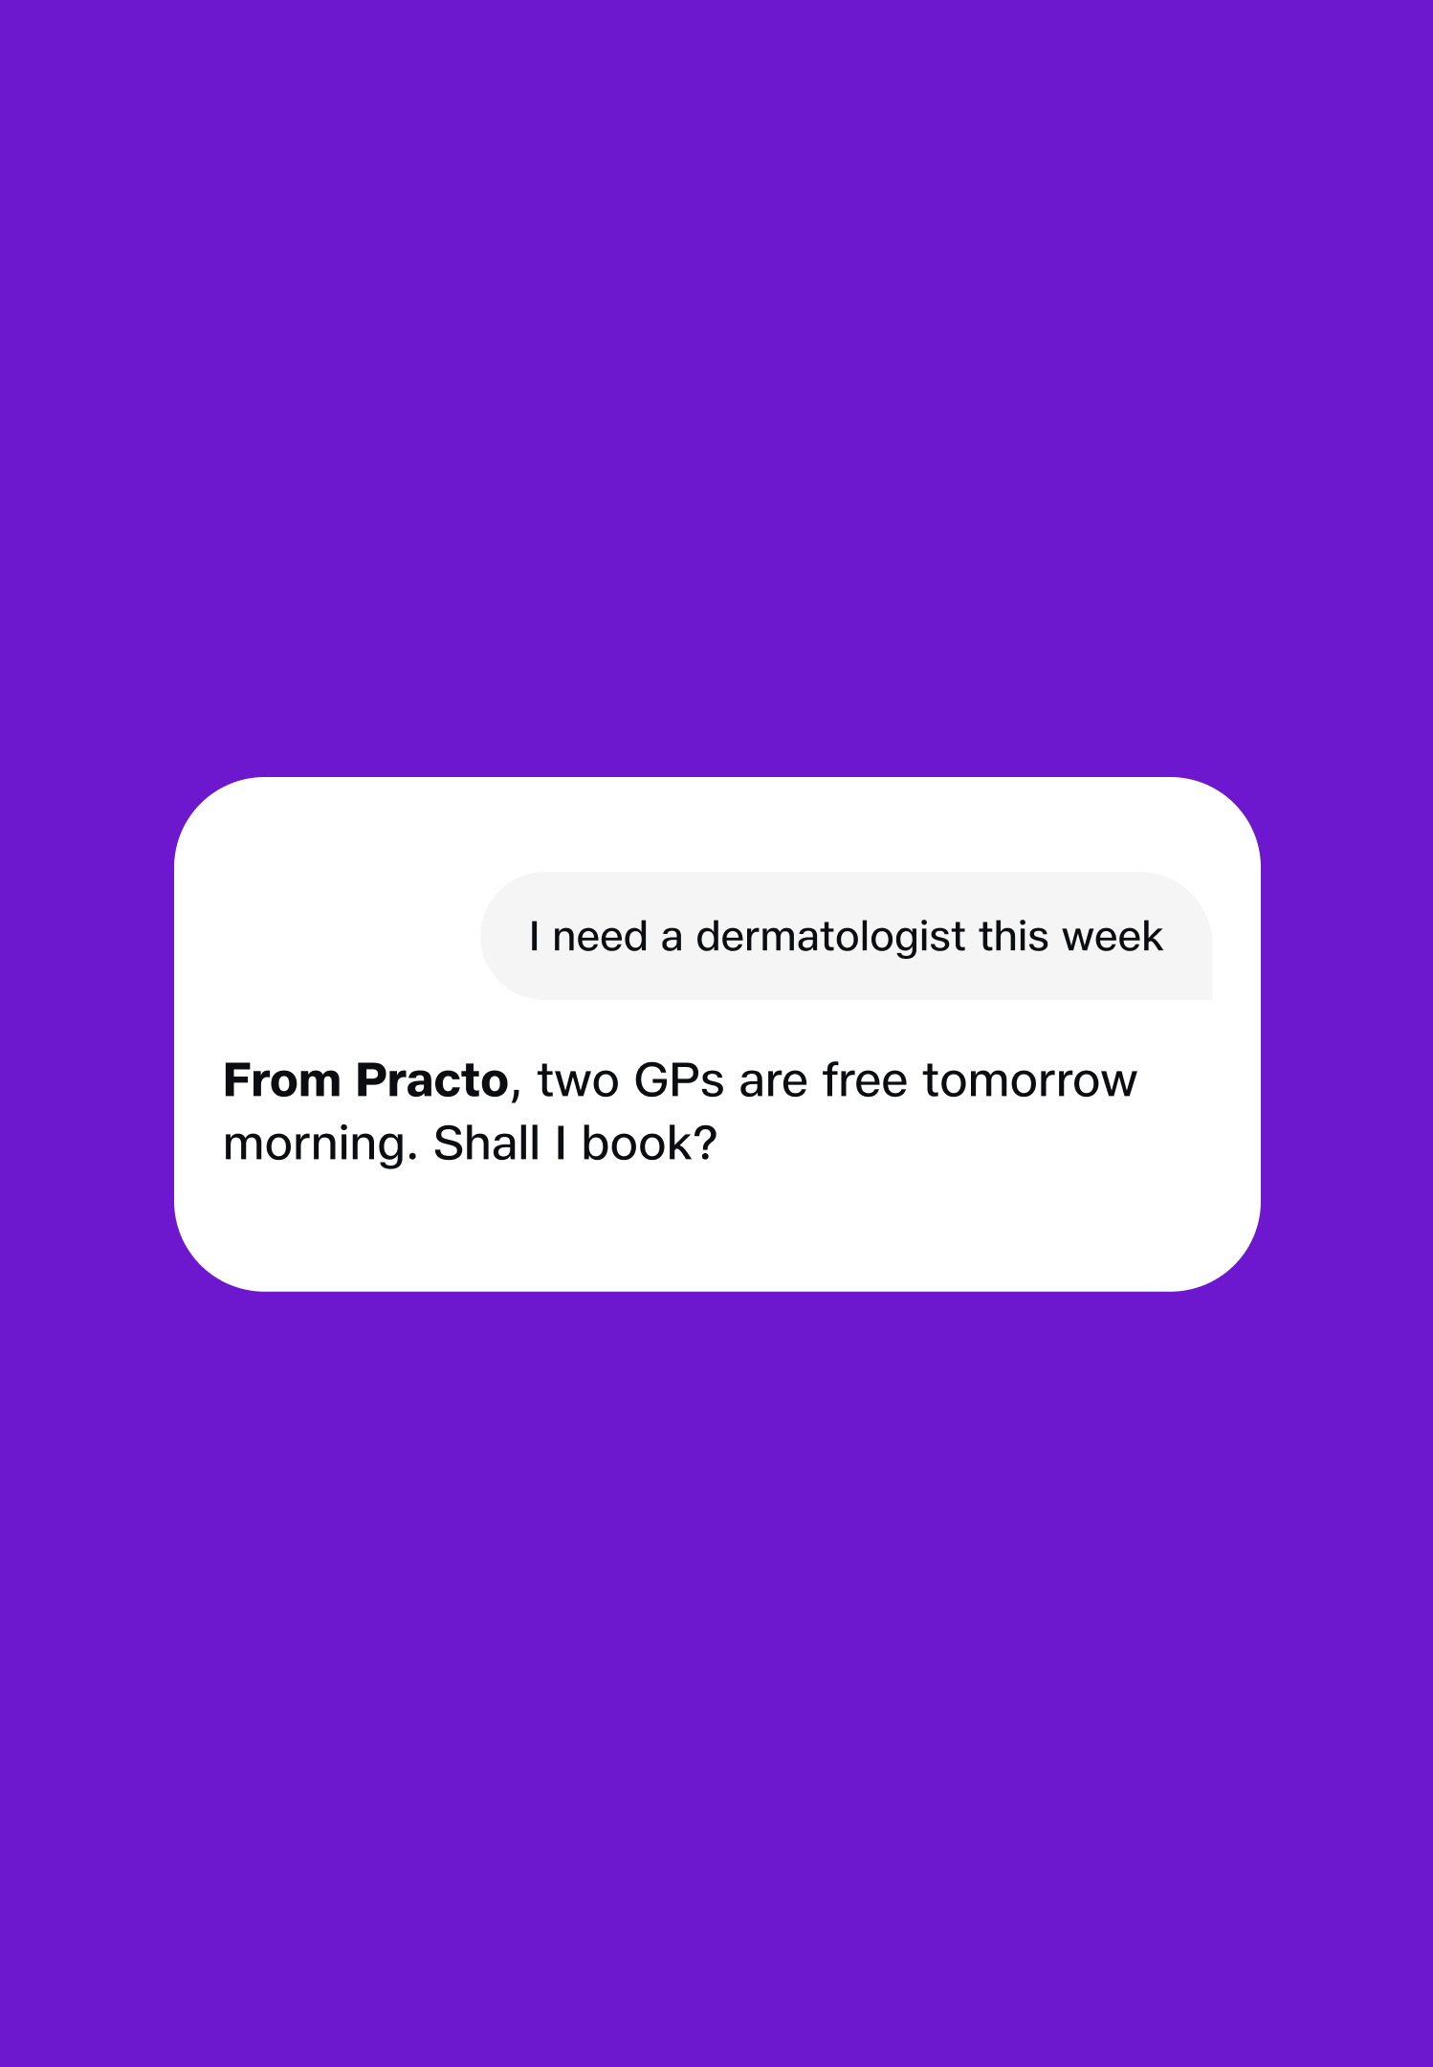
04 Voice attribution
The invisible channel where brand only reaches the user as sound.
Voice is brand's hardest surface you can't show a logo. Attribution happens through phrasing, persona, and consistent naming.
Spoken partner mention "From Practo:", "On Swiggy:"
Persona inheritance partner's selected voice persona reflects their brand tone
Confirm readbacks partner always named before money moves (non-negotiable)
Tracker updates "Swiggy says your order's 12 minutes away"
Receipt acks "Your Practo appointment is confirmed"
​
User: Trust knows who's vouching for what.
​Partner: Brand recall in the eyes-busy channel.

Slide 17
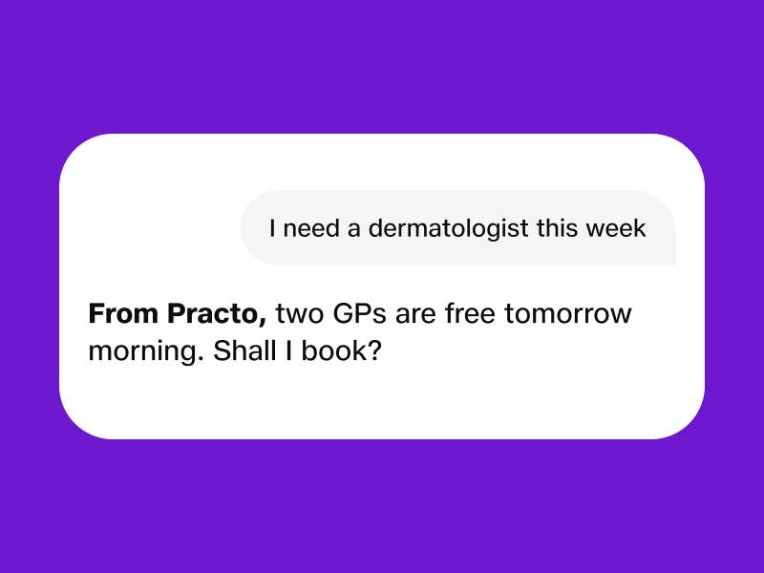
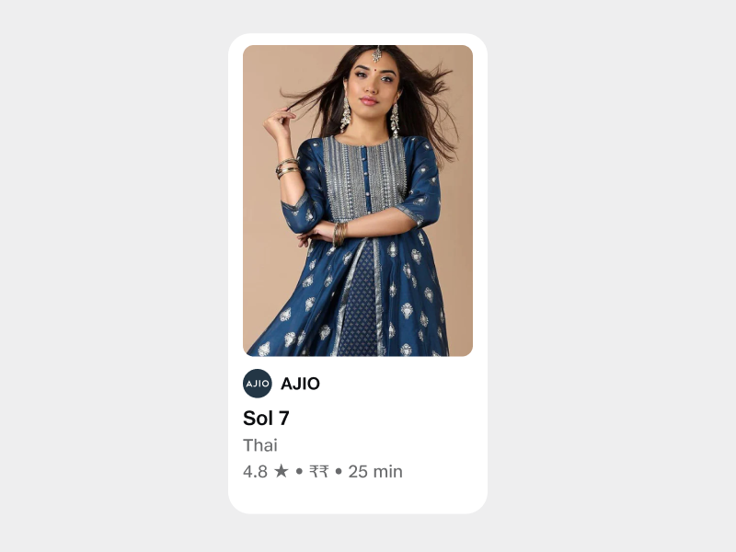
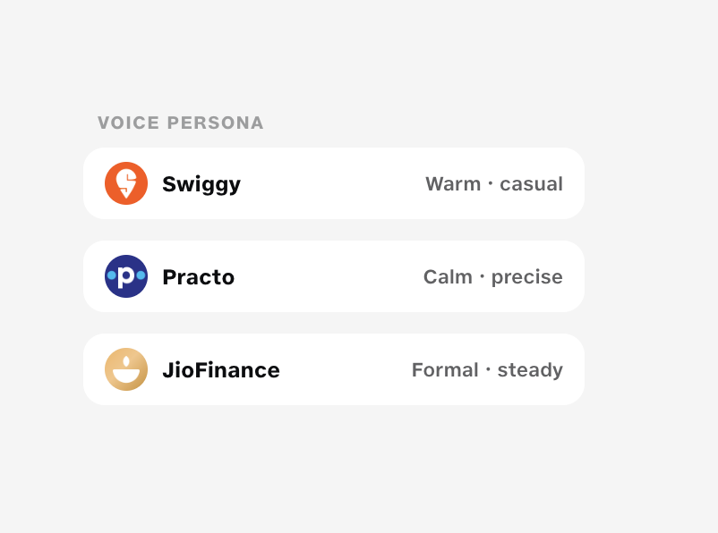
Spoken mention
Persona inheritance
Named at the start of the turn
Voice tone reflects the partner
A short partner mention before the answer. The voice equivalent of a source line, placed up front so the user knows whose data is speaking.
Each partner ships with a tonal preset. The voice persona carries their brand even when no logo is on screen.

Slide 18
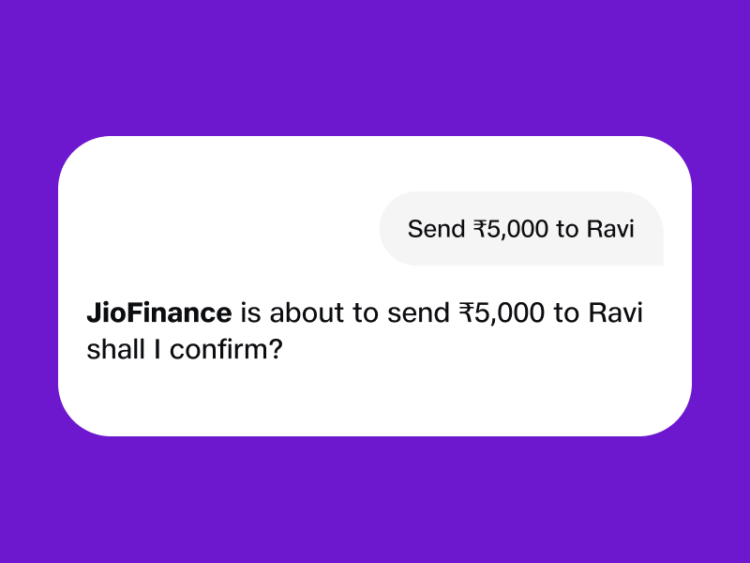
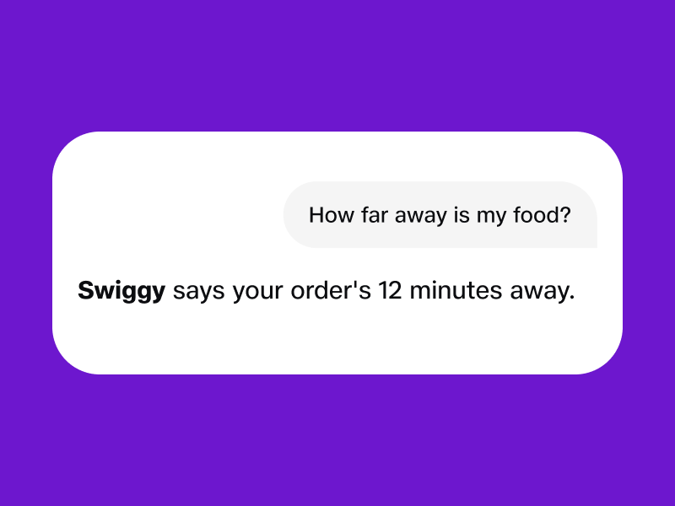
Confirm readback
Tracker update
Partner named before money moves
Partner-attributed status
Non-negotiable. The partner is always named in the spoken confirmation step so the user knows exactly who is executing.
Background updates spoken aloud always lead with the partner. Keeps long-running flows honest about whose system the update came from.

Slide 19
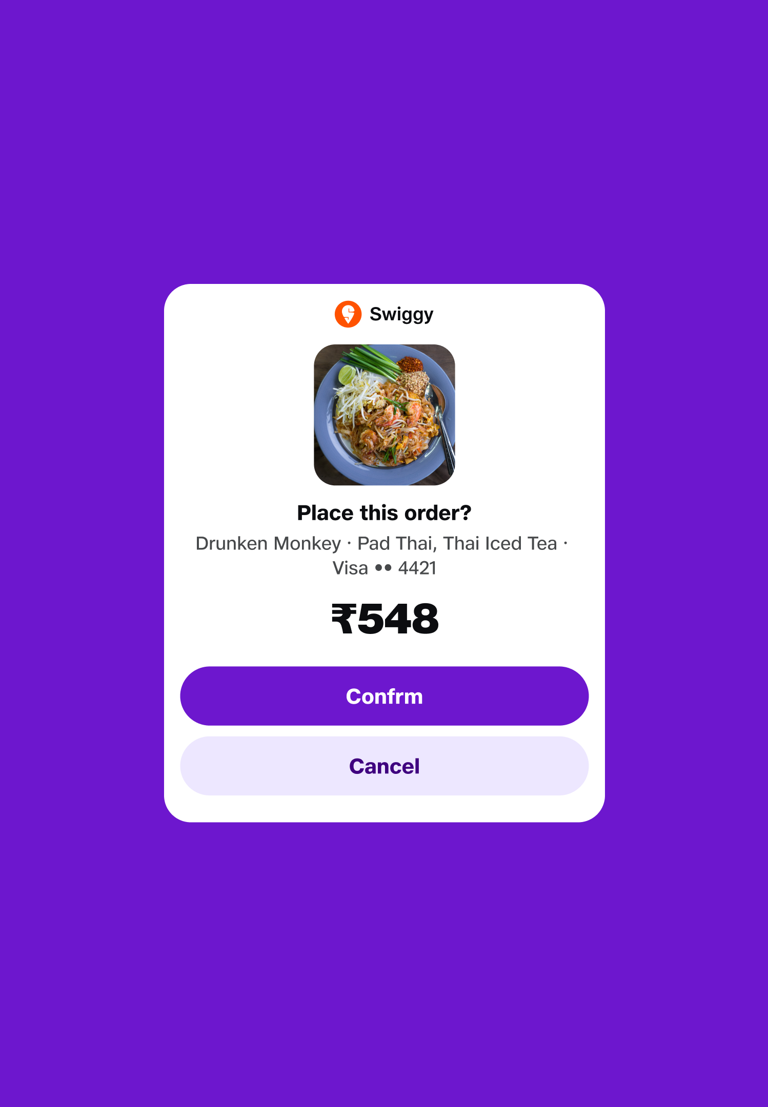
05 Transactional moments
The trust-critical zone partners are named whenever commitment moves.
Money, bookings, irreversible actions. The user has to know who's executing and how to reach them if something goes wrong.
ConfirmPanel header partner logo + name in the banner
Payment provider logos Visa, Mastercard, UPI app (separate from the partner)
Receipt header & footer order ref, support contact, terms link
Push / SMS notifications partner-branded outside the JBIQ surface
Email confirmations partner sender, partner template, JBIQ co-mark
​
User: Knows who to chase if something goes wrong.
​Partner: Extends the relationship past the JBIQ session.

Slide 20
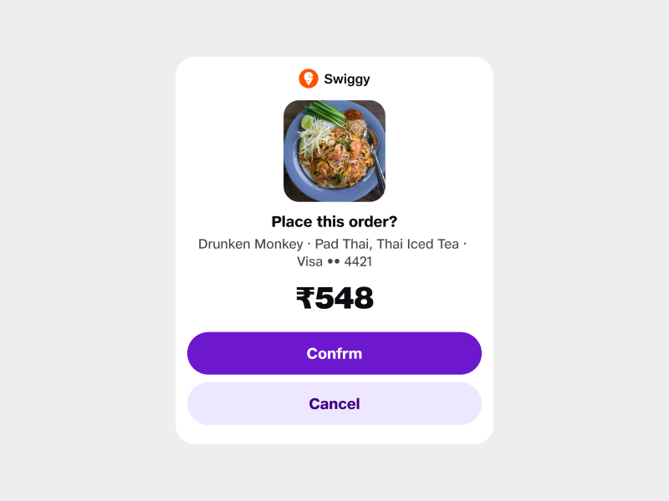
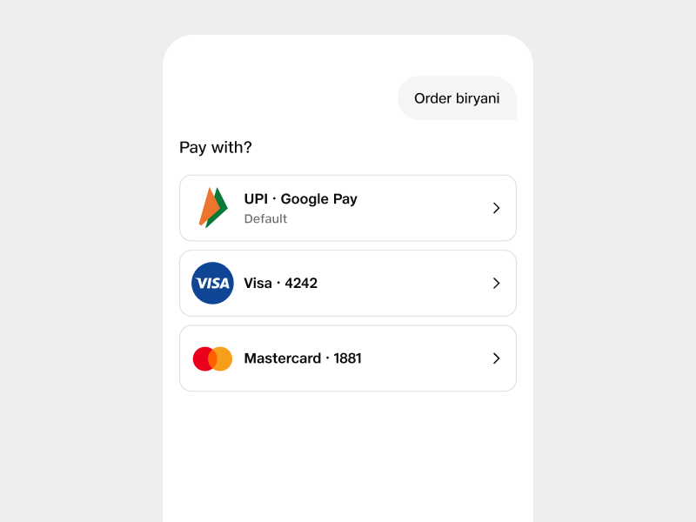
Confirm Panel header
Payment providers
Partner banner on the commit step
Rails logos, separate from the partner
When the user is about to commit, the partner is named at the top of the panel. No ambiguity about who is taking the money.
Visa, Mastercard, UPI live in their own row they don't compete with the partner brand because they answer a different question.

Slide 21
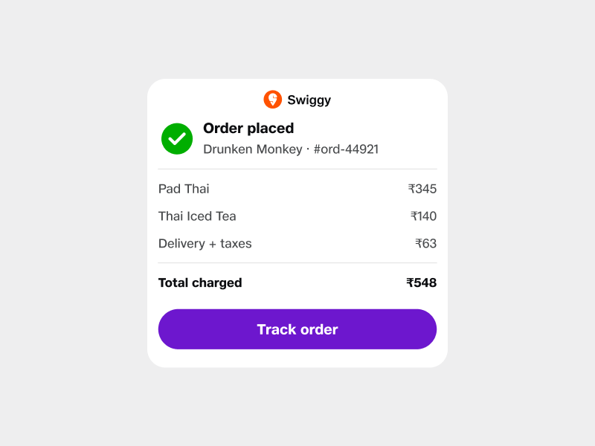
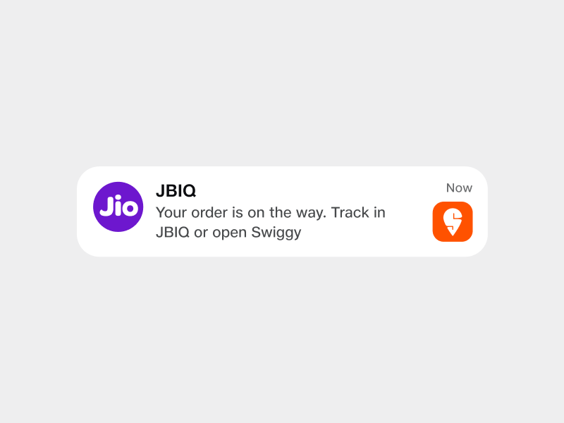
Receipt
Push & SMS
Header order ref, footer support
Partner-branded, outside JBIQ
The receipt carries the partner's brand and their support contact so the user knows exactly where to go when something goes wrong.
Outside the JBIQ surface, the partner owns the channel. Their sender, their template, with a quiet JBIQ co-mark.

Slide 22
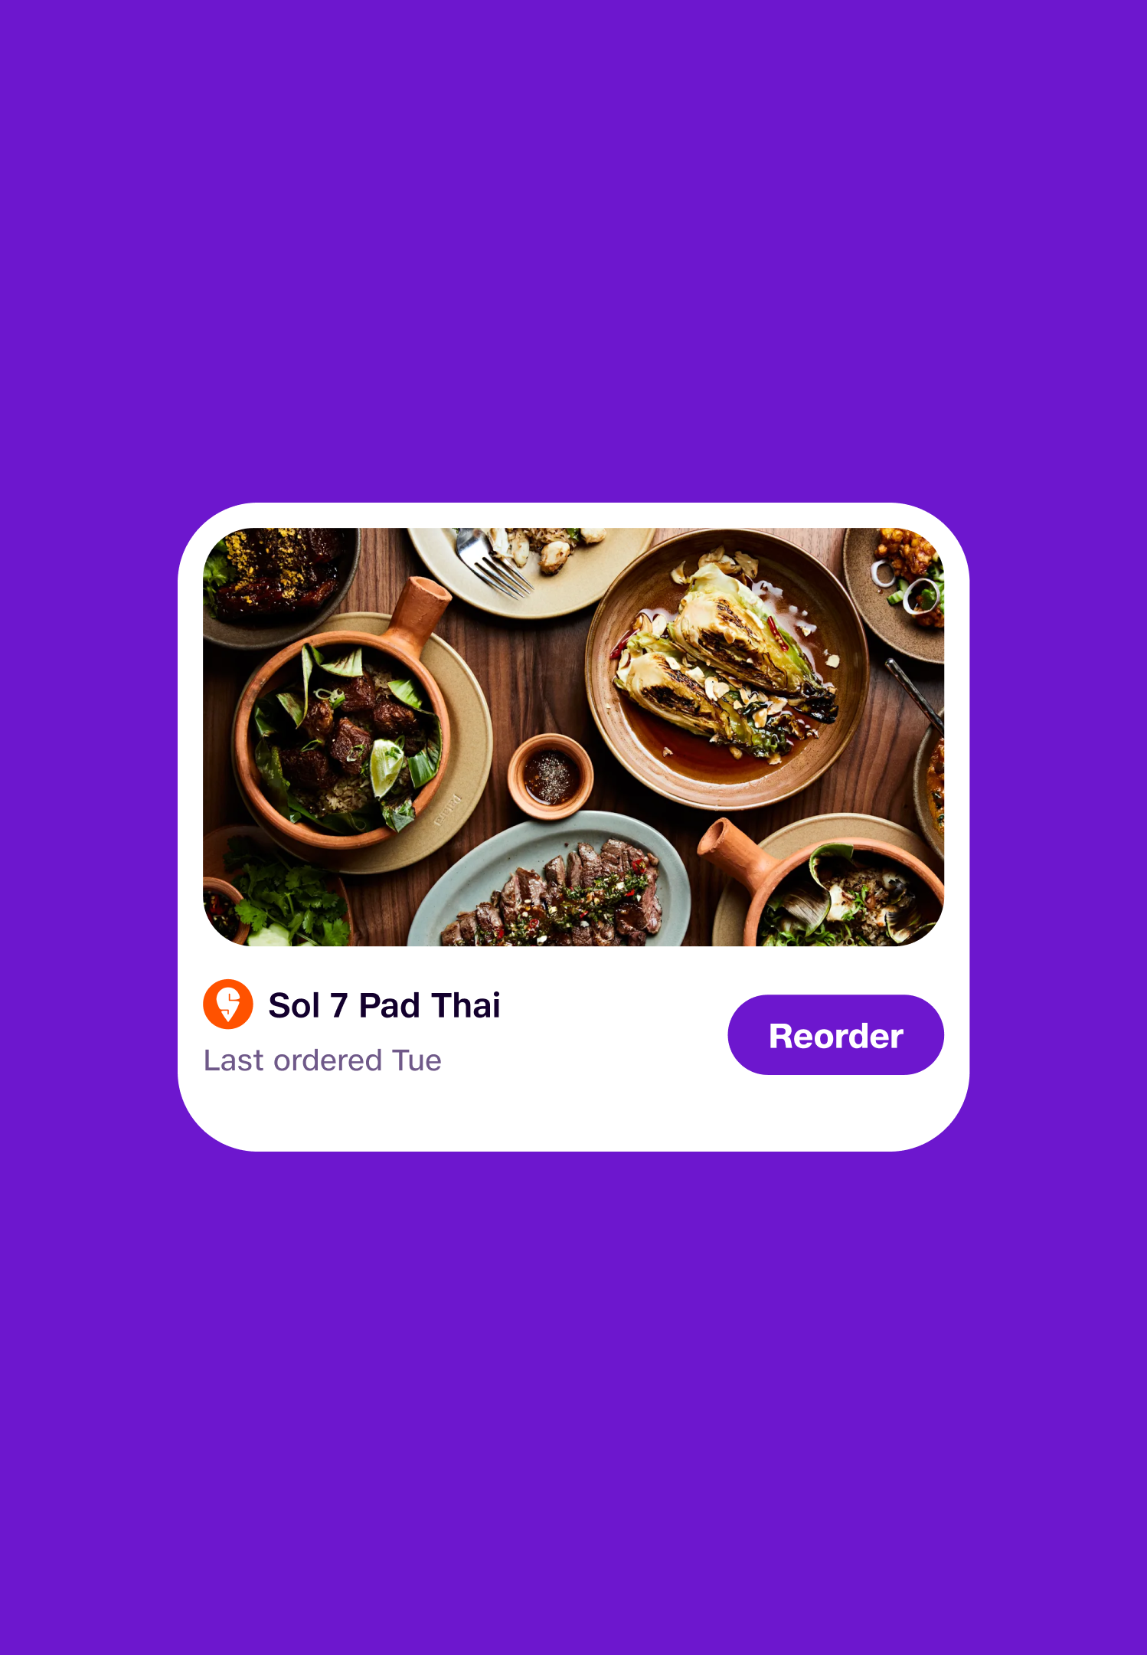
06 History & re-engagement
Where past interactions become future loyalty.
A partner's mindshare gets compounded across sessions every time the user returns, they should see the partners they've already trusted.
Session history list past sessions grouped by partner
"My orders" / "My bookings" per-partner sections
"Repeat order" partner brand preserved through the shortcut
Recommendation surfaces "Order from Drunken Monkey again?"
Loyalty / rewards mentions "You've earned 50 Retail Coins"
​
User: Continuity across sessions.
​Partner: The loyalty hook.

Slide 23
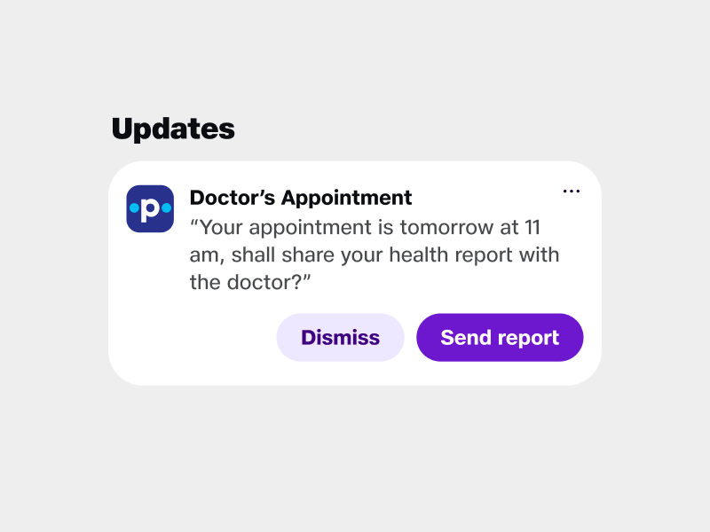
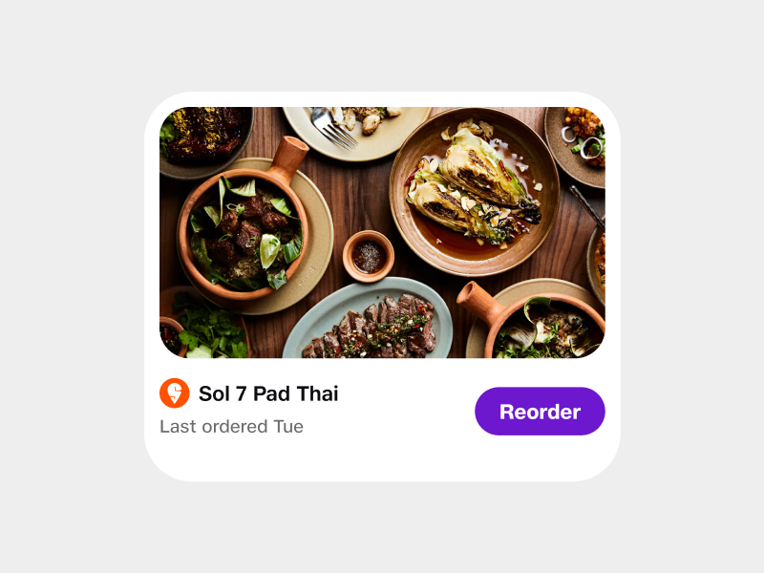
Session history
Repeat order
Past flows grouped by partner
Partner preserved through the shortcut
Looking back, the user sees the partners they've already trusted the list itself becomes a credibility signal.
One-tap repeats keep the partner's mark on the card. The shortcut doesn't quietly become a generic JBIQ action.

Slide 24
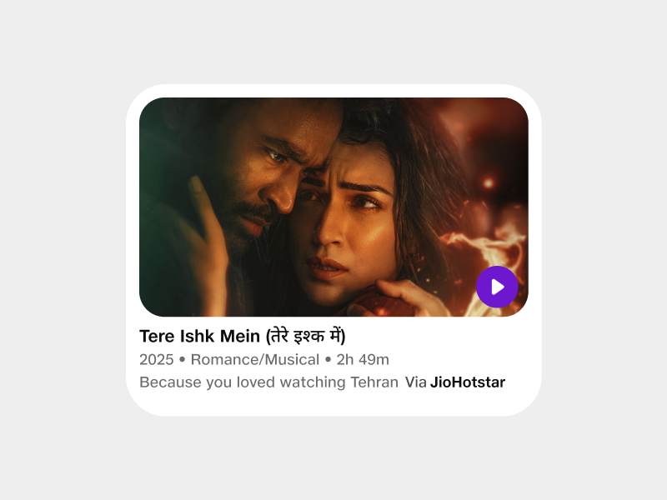
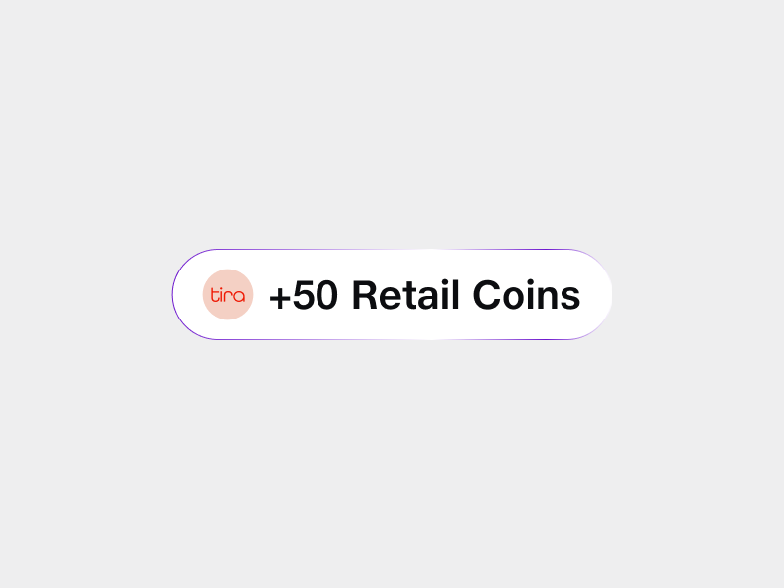
Recommendation
Loyalty & rewards
"Try this again?" surface
Partner-named earn moments
When JBIQ proactively re-surfaces something the user liked, the partner stays attached every nudge carries provenance.
Loyalty mentions name the partner's programme so the points feel like theirs and the reason to come back is theirs too.

Slide 25
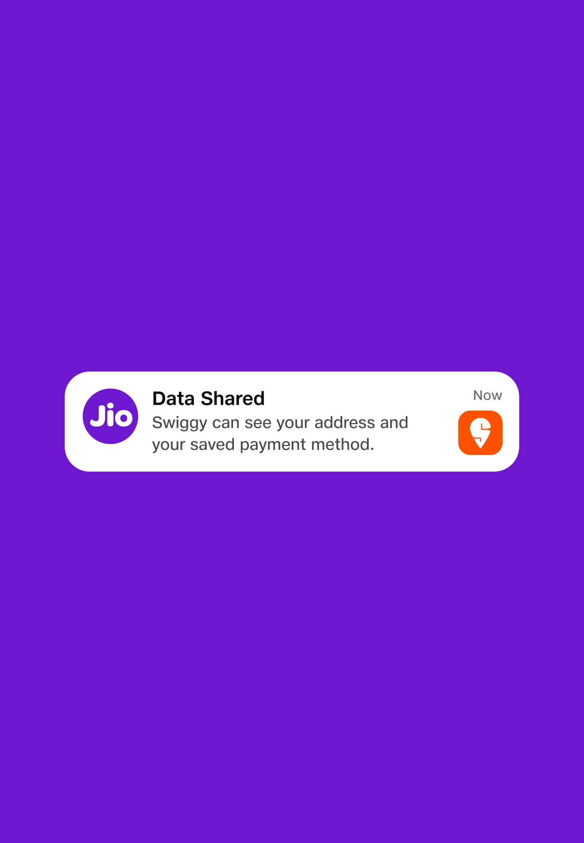
07 Trust & compliance
The non-negotiable badges issued by the system, not claimed by partners.
These are the trust marks that have to be there for regulated verticals and the disclosures that protect the user when partners read their data.
Verified partner mark system-issued, audited
Regulator badges FSSAI (food), NMC (doctors), RBI (finance), UIDAI (govt)
Privacy disclosure "Swiggy can see: your address, your payment method"
Data-shared indicator when the partner is actively reading user data
Disclaimer / liability lines "Medical advice provided by Practo, not JBIQ"
​
User: Needs these for safety and informed consent.
​Partner: Benefits from being seen as compliant.

Slide 26
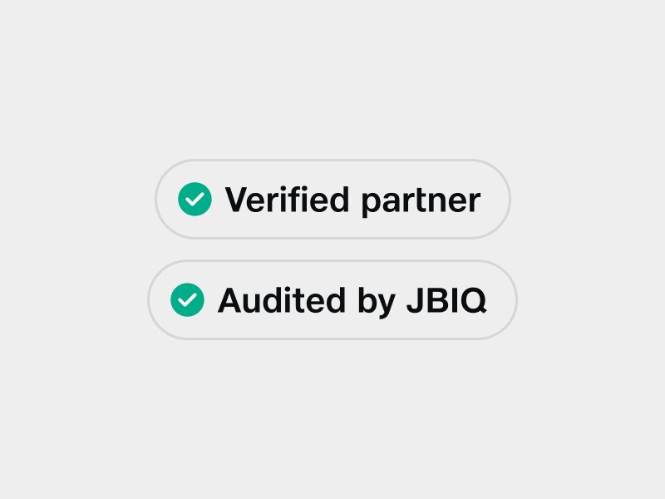
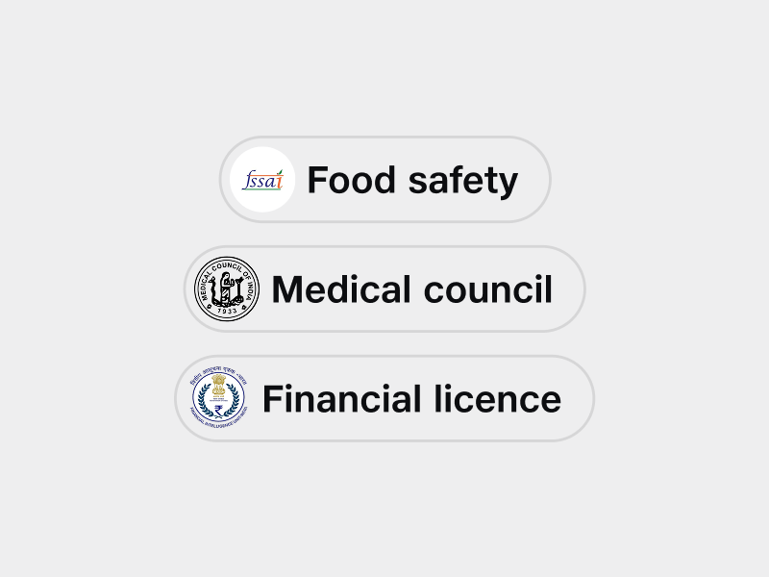
Verified mark
Regulator badges
System-issued, not partner-claimed
Licence visible in regulated verticals
The tick is JBIQ's, never the partner's. It only appears after audit which is what makes it worth anything.
FSSAI, NMC, RBI, UIDAI the body that licenses the partner shows on the card. Required for any vertical where licensing matters.

Slide 27
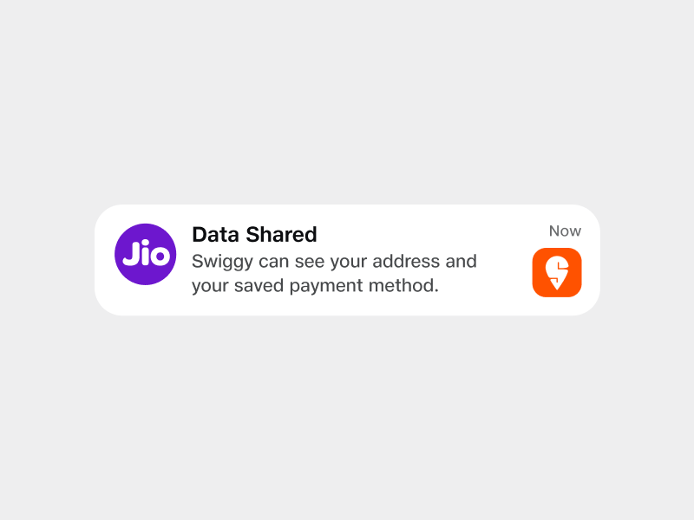
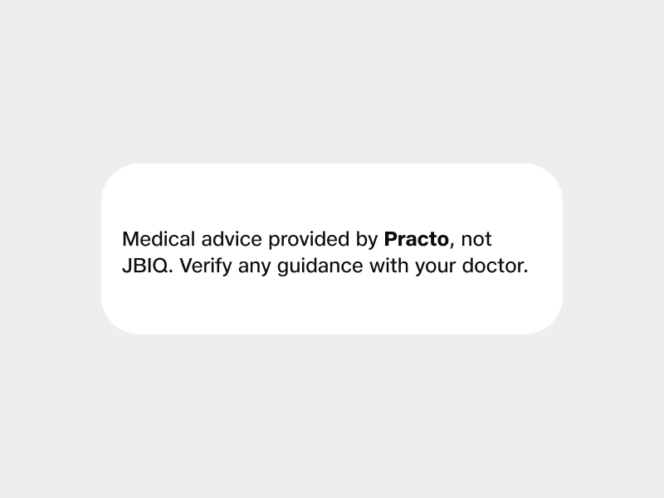
Privacy disclosure
Disclaimer
Live read-out of partner data scope
Liability stays with the partner
Whenever a partner is actively reading user data, the disclosure surfaces inline scope is explicit, revocable, and pinned to the partner.
For advice-bearing surfaces, the partner is named as the source. JBIQ holds the pipe; the partner holds the advice.

Slide 28
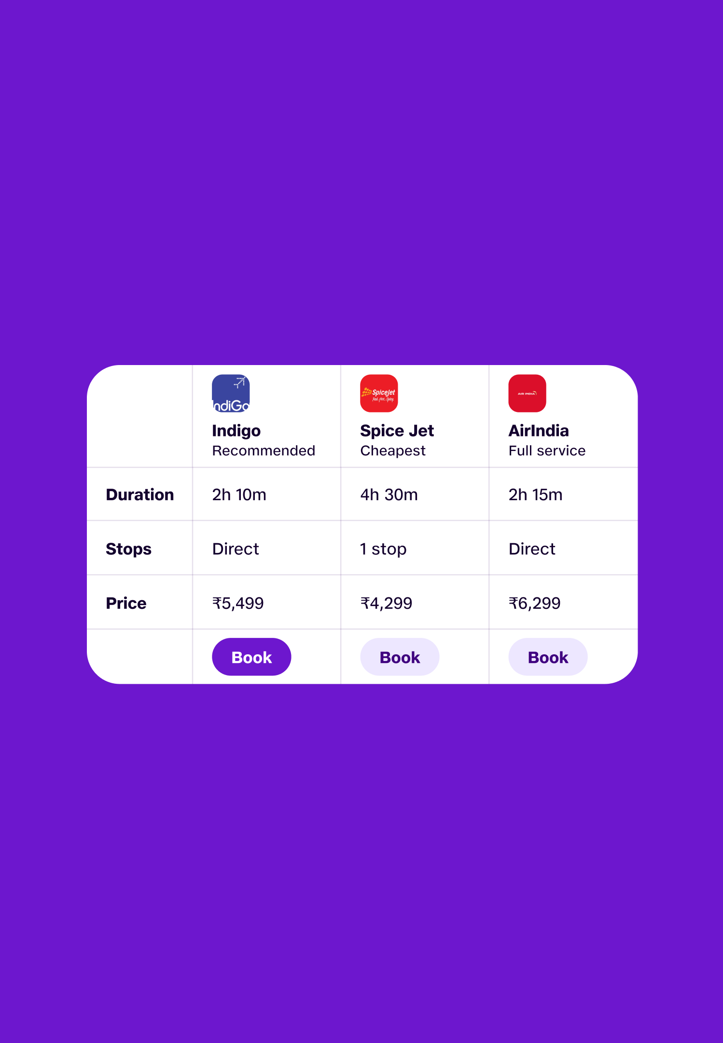
08 Cross-partner views
When the same view comes from many sources attribution stays transparent.
Comparison and aggregation are the only moments where multiple partner logos live in the same component and the rules tighten.
Comparison views multiple partner logos in the option columns
"Best from each" badges showing which source contributed which result
Aggregated source line "Showing flights from Skyscanner, MMT, and Cleartrip"
​
User: Transparency on aggregation.
​Partner: Co-mark visibility.

Slide 29
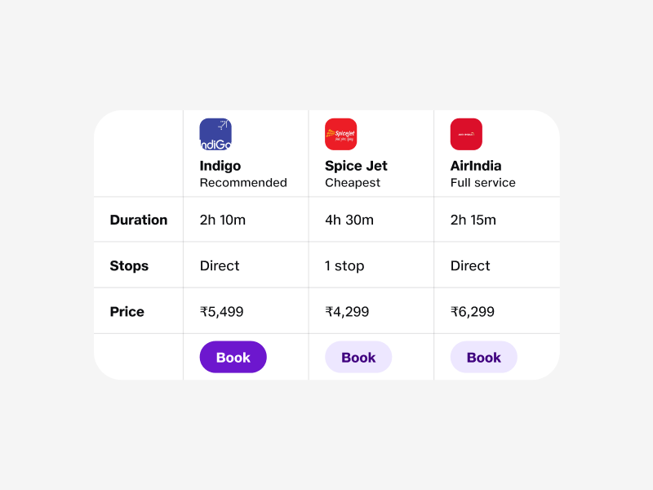
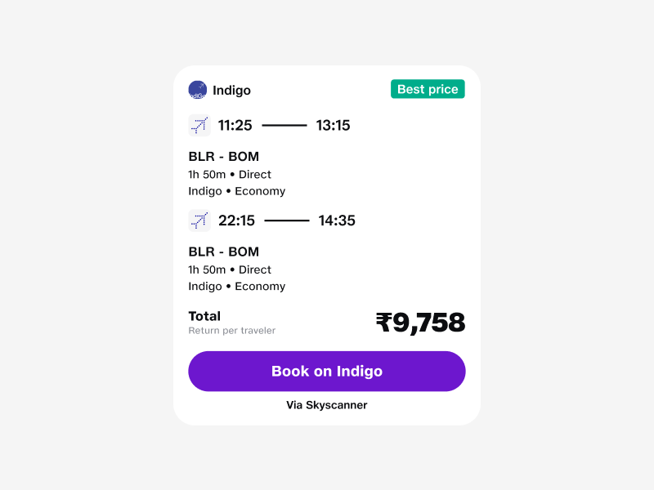
Comparison view
"Best from each" badge
Multiple partners, side-by-side
Which source won each slot
The only place several partner marks live together. Each column is owned by one source so the comparison stays honest.
When the winning option comes from a particular partner, the badge says so. No silent picking the user sees who got the result.

Slide 30
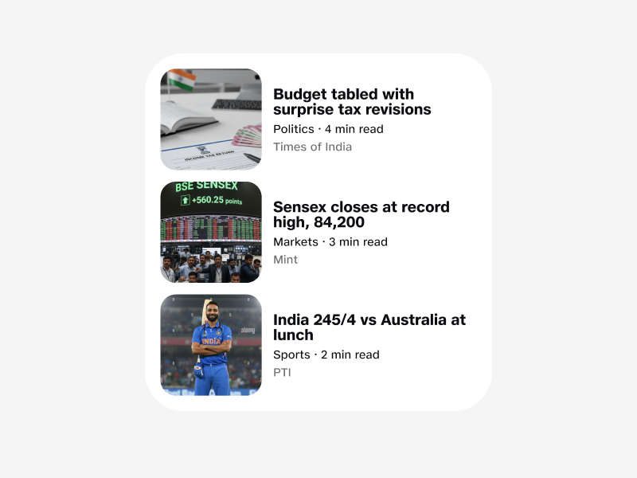
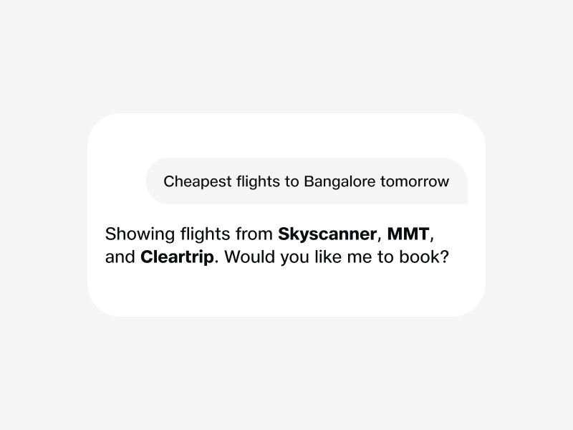
Per-row source
Aggregated source line
Rows tagged with their origin
"Showing from" header
In aggregated lists, each row carries the partner who supplied it so the user always knows which source contributed which result.
A single line above the results spells out every contributing partner. Co-mark visibility without crowding individual cards.

Slide 31
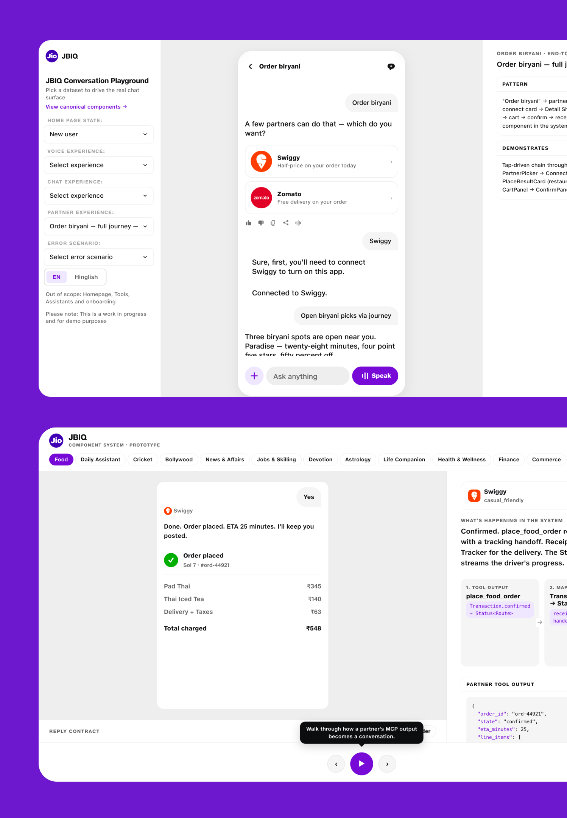
Useful Links
Experience Demo.
The live discovery experience, mobile-framed prototype showing JBIQ end to end.
Partner Sandpit.
Interactive pipeline prototype for partners, tune intents and watch the rendered responses.
Component System.
Every visual primitive across two or three verticals. Same component, different content.

Slide 32
With love,
from Jio.
May 2026 · Matt Jarvis

